Slide 1
03 | Working with Azure DNS Services
James Chambers | @CanadianJames
Simon Timms | @stimms

Slide 2
Course Topics
Applications on Azure: Putting All the Pieces Together
01 | Intro | 05 | Storing Data and Objects in Azure
02 | Exploring Application Architecture | 06 | ElasticSearch, Docker and YOU
03 | Working with Azure DNS Services | 07 | Scaling Your Application Under Load
04 | Executing Large Tasks in the Cloud | 08 | Rewind

Slide 3
Course Topics
Applications on Azure: Putting All the Pieces Together
01 | Intro | 05 | Storing Data and Objects in Azure
02 | Exploring Application Architecture | 06 | ElasticSearch, Docker and YOU
03 | Working with Azure DNS Services | 07 | Scaling Your Application Under Load
04 | Executing Large Tasks in the Cloud | 08 | Rewind

Slide 4
Working with Azure DNS Services
Please leave this area blank to allow for picture in picture recording
DNS Basics
Configuring DNS
DNS in Azure
Programmatic DNS Management

Slide 5
Terminology
Please leave this area blank to allow for picture in picture recording
DNS: Domain Name System
Registrar
TTL: time to live
Zones
Recordsets and records
TLD, SLD, extensions, domains, hosts

Slide 6
DNS Basics
Please leave this area blank to allow for picture in picture recording
joe.imagenomnom.com
joe
imagenomnom
com
Notes:
Top level domain – .com, .net, .org, .edu etc + country codes + specials
Second level domain - involves registrars
Third level, subdomain, host name – you typically set these

Slide 7
DNS Basics
Please leave this area blank to allow for picture in picture recording
jon.imagenomnom.com
40.112.142.148

Slide 8
Configuring DNS
Please leave this area blank to allow for picture in picture recording
Register a domain
Delegate name resolution
Create requisite records

Slide 9
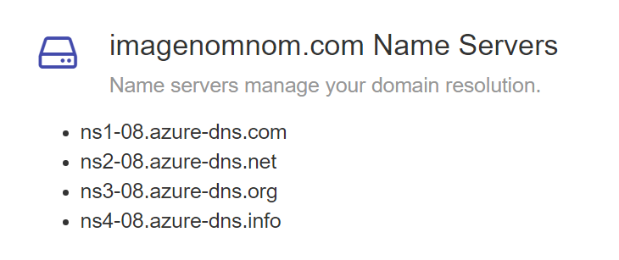
Name Resolution
Please leave this area blank to allow for picture in picture recording

Slide 10
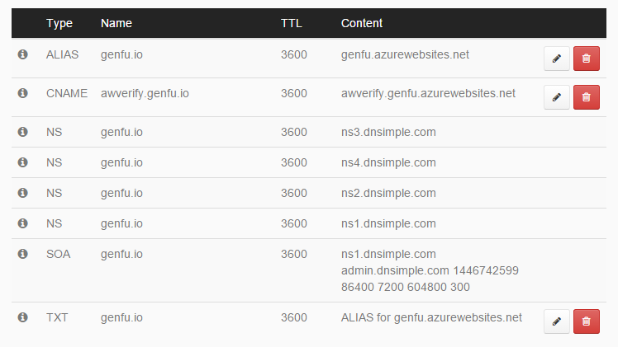
DNS Entries
Please leave this area blank to allow for picture in picture recording

Slide 11
Considerations
Please leave this area blank to allow for picture in picture recording
Services simplify DNS concerns and management
Caching can have an impact on record resolution
You usually don’t have to worry about it after setting things up

Slide 12
Our Scenario
Please leave this area blank to allow for picture in picture recording
Create entries for each registered user
Read our information from a queue
Process entries in a background process
joe.imagenomnom.com

